Slide 1
CITY OF SOMERSET
FY 2016 BUDGET
PREPARATION AND
INFORMATION

Slide 2
Cash Balance March 2008

Slide 3
Cash Balance March 2009

Slide 4
Cash Balance March 2010

Slide 5
Cash Balance March 2011

Slide 6
Cash Balance March 2012

Slide 7
Cash Balance March 2013

Slide 8
Cash Balance March 2014

Slide 9
Cash Balance March 2015

Slide 10
One Time Expenses
All discussed and most voted on by Council
Some budgeted, some not
All good ideas
All good for the City and the Community
Almost all money comes from cash on hand

Slide 11
One Time Expenses
Midtown Sewer $1,200,000

Slide 12
One Time Expenses
Midtown Sewer $1,200,000
Water Plant $788,850

Slide 13
One Time Expenses
Midtown Sewer $1,200,000
Water Plant $788,850
Town Springs $342,000

Slide 14
One Time Expenses
Midtown Sewer $1,200,000
Water Plant $788,850
Town Springs $342,000
Firefighters Lawsuit $518,607

Slide 15
One Time Expenses
Midtown Sewer $1,200,000
Water Plant $788,850
Town Springs $342,000
Firefighters Lawsuit $518,607
EMS Shortfall FY 2014 $166,976

Slide 16
One Time Expenses
Midtown Sewer $1,200,000
Water Plant $788,850
Town Springs $342,000
Firefighters Lawsuit $518,607
EMS Shortfall FY 2014 $166,976
Lazy River Repairs $147,290

Slide 17
One Time Expenses
Midtown Sewer $1,200,000
Water Plant $788,850
Town Springs $342,000
Firefighters Lawsuit $518,607
EMS Shortfall FY 2014 $166,976
Lazy River Repairs $147,290
Resurface Slides $158,050

Slide 18
Parks One Time Expenses
Marydale $50,000 $205,364

Slide 19
Parks One Time Expenses
Marydale $50,000 $205,364
Woods Park $18,602 $104,932

Slide 20
Parks One Time Expenses
Marydale $50,000 $205,364
Woods Park $18,602 $104,932
Huffaker Splash Pad $30,278 $25,636

Slide 21
Parks One Time Expenses
Marydale $50,000 $205,364
Woods Park $18,602 $104,932
Huffaker Splash Pad $30,278 $25,636
Amphitheatre $224,700

Slide 22
Sanitation One Time Expenses
Trash Cans $157,774

Slide 23
Sanitation One Time Expenses
Trash Cans $157,774
Recycle Cans $92,214

Slide 24
Sanitation One Time Expenses
Trash Cans $157,774
Recycle Cans $92,214
Garbage Truck $169,158

Slide 25
Gas Credits last 2 Years
2014 $30 for every City customer (Residential and Commercial)
2014 $15 for every residential customer outside the City limits
2015 $30 for every City residential customer
What did it cost?

Slide 26
Gas Credits last 2 Years
2014 $30 for every City customer (Residential and Commercial)
2014 $15 for every residential customer outside the City limits
2015 $30 for every City residential customer
What did it cost?
$120,000 $217,065 $337,065

Slide 27
Other Property Purchases
Ohio St $70,000
Lincoln St $15,350
Cemetery Office $55,181
Maple St Apts $57,119
Hamilton Lane $32,500
Randolph St $18,900

Slide 28
Total Cash Spent
$4,986,546

Slide 29
Cash Balance March 2015

Slide 30
Cash Needs
$15M cash on hand today
Approx $6M for daily cash flow
Approx $4M for bond requirements
How much over and above for emergencies, projects, unplanned shortfalls
How much is too much to have on hand

Slide 31
Water Park Financials
Water Park will not clear $1,000,000/year
Operating the Y pool costs over $25,000
Helping Cal Ripken costs over $30,000
Fireworks twice per year costs $45,000
Summer work program for kids
First price increase this year
Water Park lost $480,000
Council wants to offer free days and military discounts

Slide 32
Full Time Employment 290
Added 59 full time employees since 2008
Police 6, Fire 2, EMS 10
Gas 6, Water 8, Wastewater 3, Sanitation 4
Parks 5, Utility Billing 1
Cemetery 1, Fuel Center 1, ABC 2
No increase in Engineering, Street, Garage, Water Park, P & Z
Executive 10 (CFO, Housing, Safety, IT, Acct 2, Accts Pay 1, Projects 1, Events 1, Records 1

Slide 33
Yearly Raise Costs
290 Employees @ $1,000 = $290,000
Matches & Retirement = $110,000
Carries over year after year after year
Also increases overtime rates and Worker’s Comp rates

Slide 34
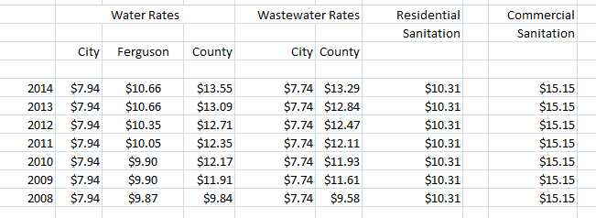

Slide 35
UTILITY TRENDS

Slide 36
SEWER DEBT

Slide 37
WATER DEBT

Slide 38
Utility Receivables March 2015
Gas $1,165,459.03
Water $170.197.15
Sewer $158,461.09
Sanitation $223,040.95
Total $1,717,158.22

Slide 39
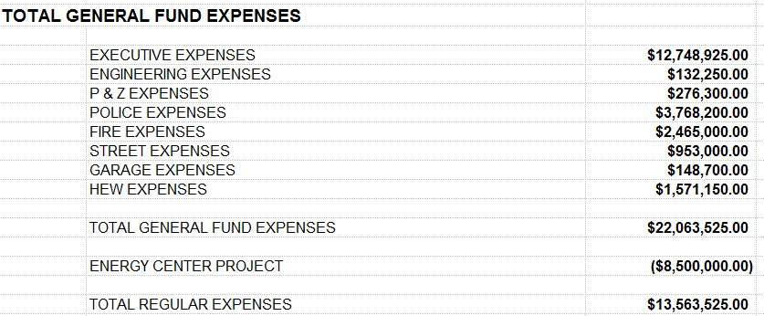
2015 General Fund Actual Budget Expenses

Slide 41
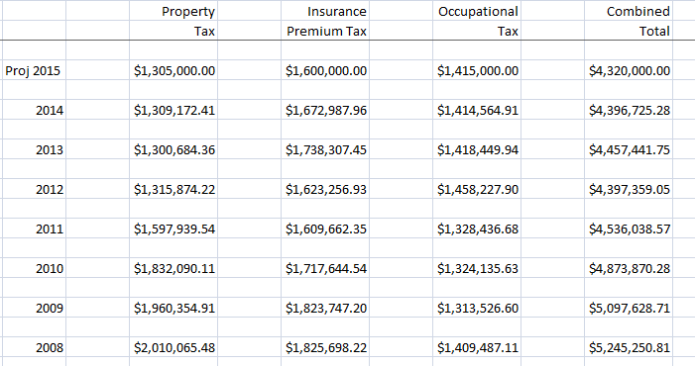

Slide 42
Occupational Tax total receipts 2008 = $8,346,552.45
Occupational Tax total receipts 2014 = $9,729,774.82

Slide 43
Things to Remember
Utility rates have not increased since 2008
Property taxes have been decreased
Parks fees reduced
EMS forgiven debt to County $800,000
Revenues have been cut or are flat
Expenses keep going up every year
Think about what your actions “cost”

Slide 44
Total Cash Spent
$4,986,546

Slide 45
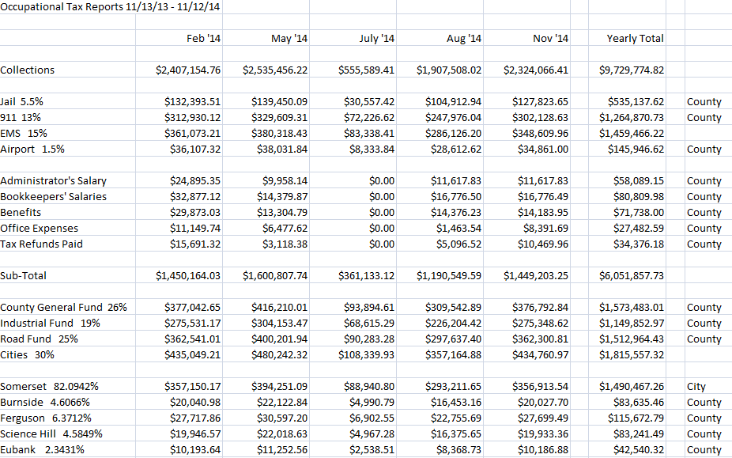

Slide 46
